Slide 1
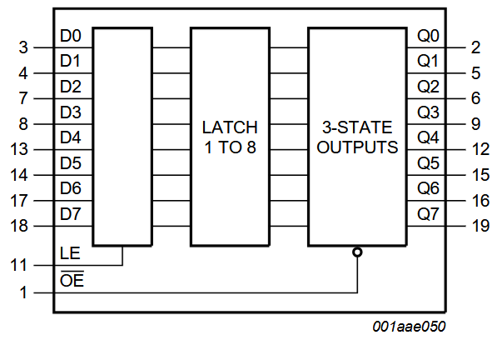
Chips to make 16 bit latch without inc/dec
Need 2 x 74HC373 to make a 16 bit latch with tri-state outputs.

Slide 2
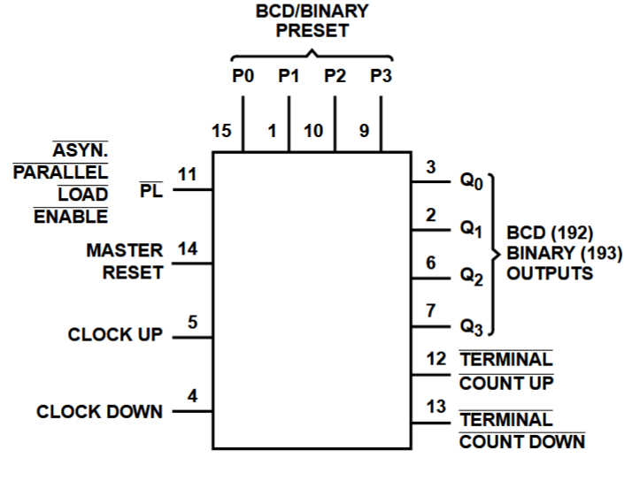
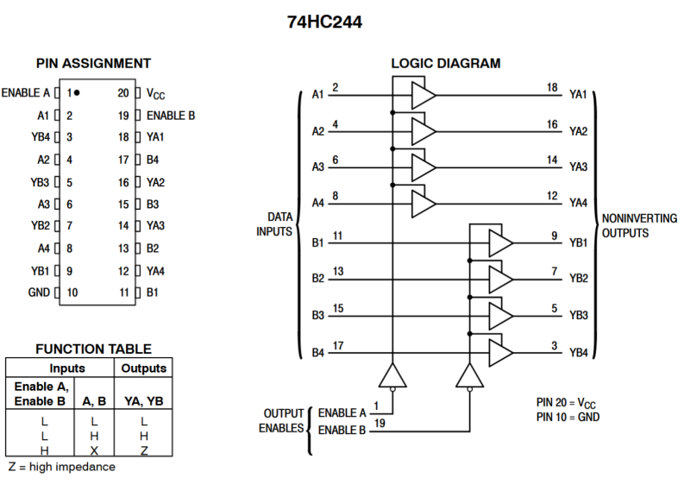
Chips to make 16 bit latch with inc/dec
Need 4 x 74HC193 to make a 16 bit counter.
It can work like a latch because we can load it via P0..P3 using PL
Also need to connect Q3..Q0 x 4 via 16 bit tri-state buffer to data bus
Need 2x 74HC244 for this

